Slide 1


Smart City Parking System Linking Private and Public / Parking with Trafikverket
SENSEPARK
Mushtaq Ali Hamidani (Ali)
v24musal@du.se /
aleisverige@gmail.com

Slide 2
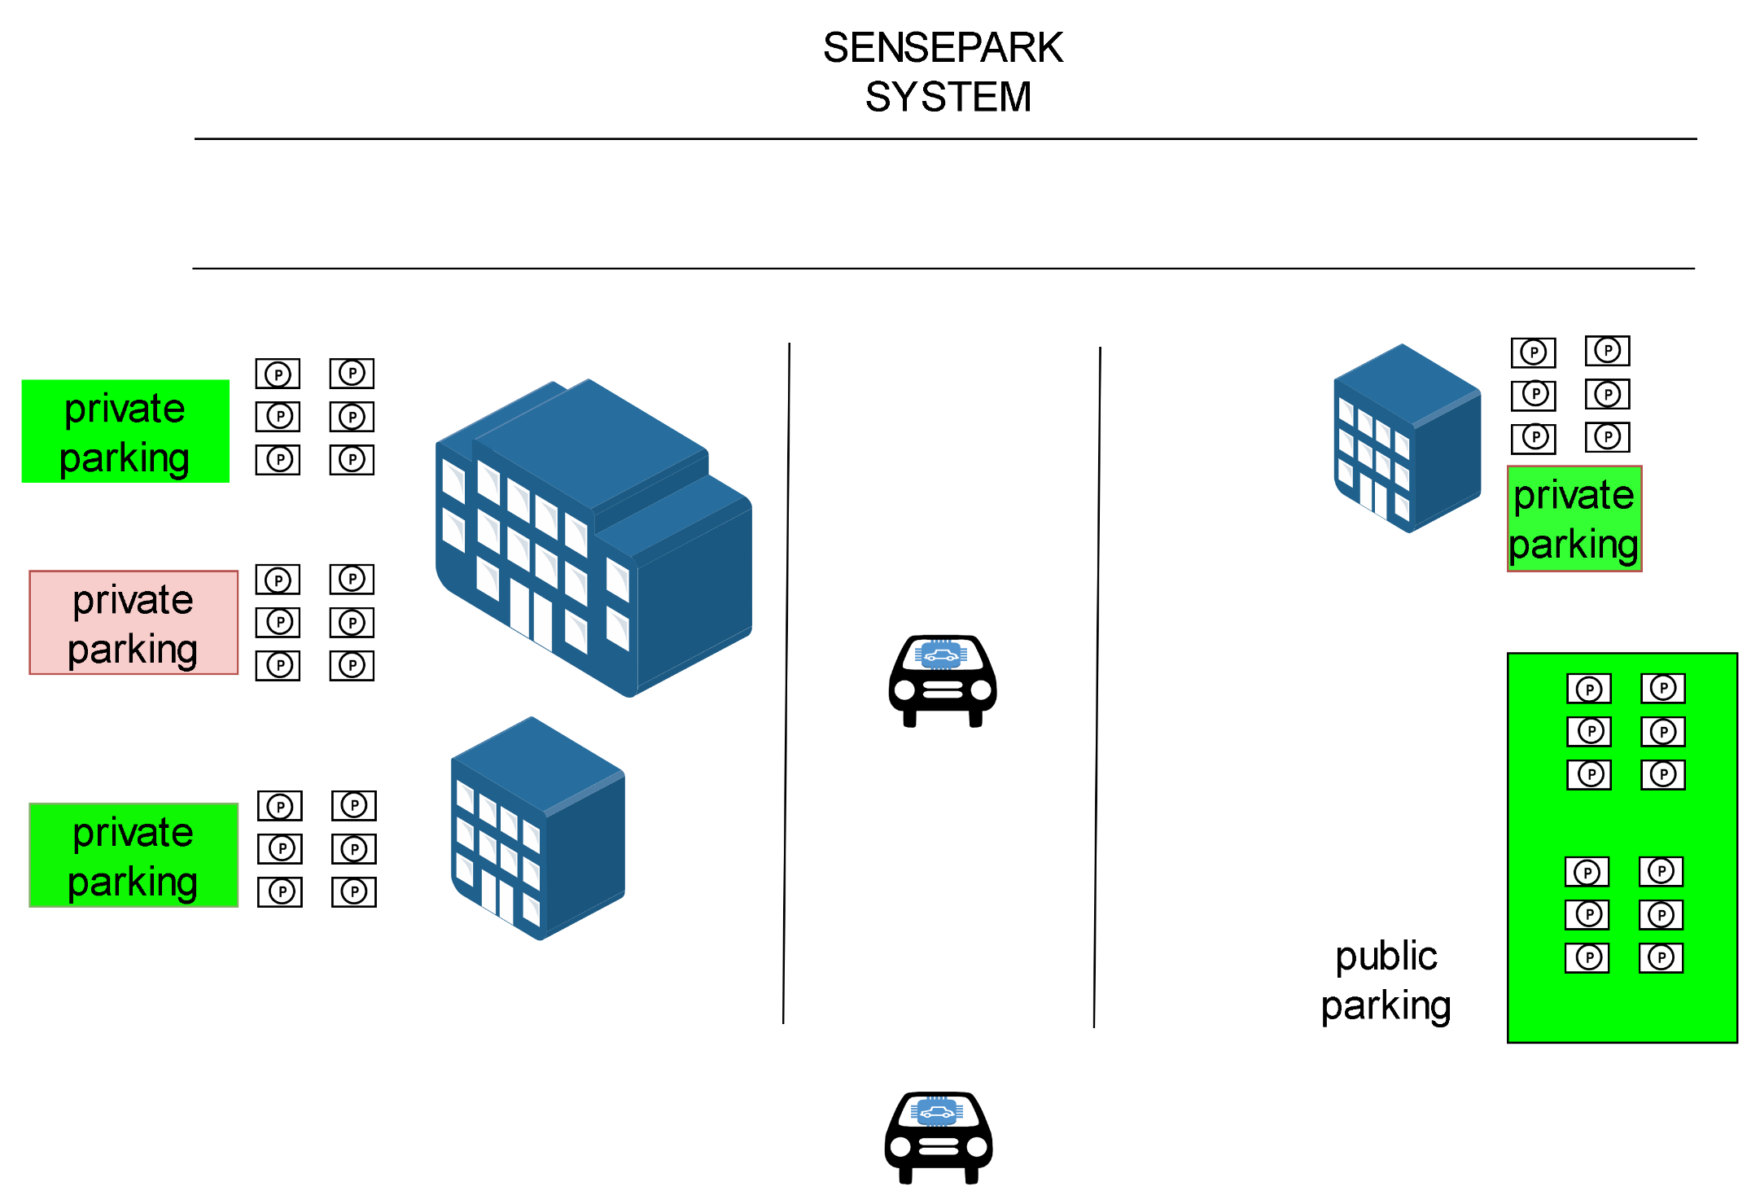

Slide 3

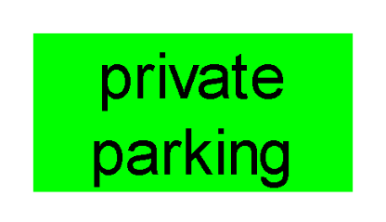
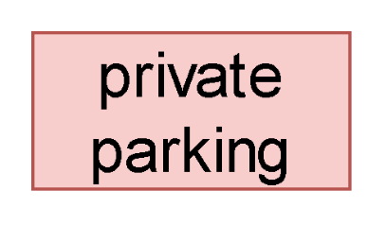
Parking registered with Trafikverket as available for public
Parking Not registered with Trafikverket as available for public
Objective: Public / Private partnership

Slide 4

Benefit to People
Convenience
Possible cheaper parking
Less cost on infrastructure
Benefit to Government
More visibility of parking
Parking space can pull people to your premise which can translate into more business opportunity
Business can earn from parking
Benefit to Business

Slide 5
Possible Data Sharing
Information to be shared between property and trafikverket
Longitude / Latitude
time of arrival
advance booking (optional)
opening / closing time for private property
private/public parking category
parking location , floor , number
price : cost per hour / free

Slide 6
Further Development
Autonomous cars can find nearest parking if registered with trafikverket
Premise owner can be paid automatically once the car leaves the premise

Slide 7
Thank You

